Slide 1
2014 PCC Annual Meeting June 17, 2014

Slide 2
Spring 2014 League Champions

Slide 3
Spring 2014 Champions
Winners of the Consolation game: Team Delauder
Dave Delauder
Grant Burrows
Mike Queen
Troy Lanford

Slide 4
Spring 2014 Champions
Finishing in Third place, Teams Rasmussen are winning the Bronze medals. In a friendly game team Rasmussen B7 beat Team A3 by a score of 8 - 2
A3 Ron Rasmussen B7
Kay Oken Ryan Smith
Griffen Whittington Dave Smith
Mary Whittington Derek Pederson

Slide 5
Spring 2014 Champions
Finishing in Second place losing 8-7 in a very tight game, Team Sharkey wins the Silver medals
Matt Sharkey
Eddie Shirley
Dan Couture
Cale Kirby
Kristen Kirby

Slide 6
Spring 2014 Champions
Our Club Champions and South Carolina’s Champions winning 8-7 in a very tight game, Team Fort wins the Gold medals and the championship trophy
Daniel Fort
Matt Cooney
Dannie Newell
Brian Steadman
Beau Welling

Slide 7
2014 Arena Clubs National Championship

Slide 8
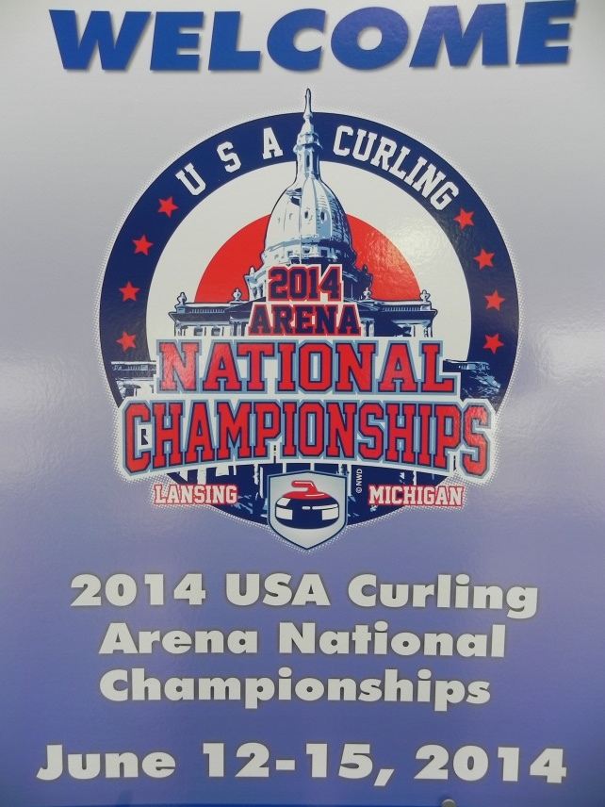
2014 Arena Clubs National Championship
The Palmetto Curling Club was well represented both in the Women and Men’s categories

Slide 9
Our representatives
Team Wiggins
Team Fort
Anne Wiggins
Nicole Plante
Sherri Odlevak
Lisa Cobb
Skip
Third
Second
Lead
Daniel Fort
Ryan Smith
Matthew Jones
Kurt Wagner

Slide 10
Participants
Alexandria, MN
Burnsville, MN
Lansing, MI
La Crosse, WI
Kalamazoo, MI
Long Island, NY
Chicago, IL
Pittsburgh, PA
Indianapolis, IN
San Francisco, CA
Cincinnati. OH
Colorado
Springs, CO
Richmond, VA
Oklahoma
City, OK
Charlotte, NC
Greenville, SC
Dallas, TX

Slide 11
Dedicated Ice Project
Bill Marshall

Slide 12
Dedicated Ice Project
Greenville County will not take the ice down this summer
Project to have two rinks with ice
Greenville County have selected the Architects
Architects will meet with all user groups, including PCC in the coming weeks
We are requesting four sheet of dedicated ice for curling.

Slide 13
Palmetto Curling Club Adopt-a-Rock Program

Slide 14
Adopt-A-ROCK Program from the Palmetto Curling Club!
An opportunity to contribute to the:
Payment of the rocks
Dedicated ice fundraisers.
Offered to all (club members, corporate entities. etc.,)

Slide 15
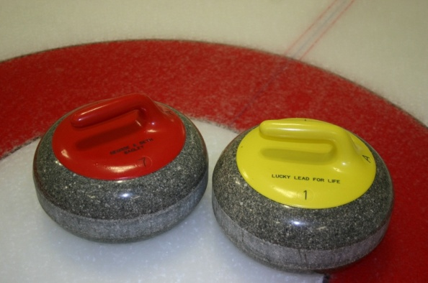
What is *Adopt-A-ROCK program*?
Each adopted rock will have its handle engraved on 1 side with your personal inscription (subject to acceptance by the Board members).

Slide 16
Adopt-A-ROCK program
Consider adopting a rock as:
A gift to celebrate a special occasion
(i.e. the birth of your child)
A memorial to a family member or a friend
An opportunity to promote your business/organization
A personal tribute
A tribute to someone who has contributed to the club by volunteering, etc.,
Selection of sheet, rock number and color on a first-paid/first-served basis.
Priority to the Club members over the corporate entities until the end of the year.
Cost: $250 per rock for individuals and $500 for Corporations

Slide 17
How does it work?
Check on the website for the availability of the rock(s) you wish to have engraved:
Decide what you would like to have engraved on the handle (1 line).

Slide 18
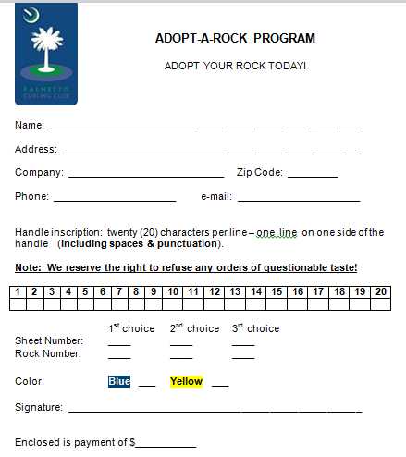
How does it work?
Fill out an “Adopt-A-Rock” pledge form
http://palmettocurling.com/adopt-a-rock/

Slide 19
How does it work?
The cost to adopt a rock is $250.00 and you will receive a donation receipt for your tax return.
Send the pledge form and the check to (or give them to me at game night):
Nicole Plante
27 Birchstone Court
Simpsonville, SC 29681

Slide 20
How does it work?
If the rock is still available:
Rock Reserved for you.
The plastic handle will be engraved with your board-approved message.
A picture of the rock will be sent to you as confirmation.

Slide 21
2014 – 2015 Membership

Slide 22
2014 – 2015 Membership
Membership fees are allowing us to cover a portion of our fixed costs:
Dues to the USCA and the GNCC
Insurance
Web Site
Equipment renewal
Etc.

Slide 23
2014 – 2015 Membership
Membership fees are due annually and run June through May of the following year.
Membership fees for the 2014 & 2015 season will remain at $ 125.
Payable to the club No later than October 7, 2014
It is mandatory to be fully paid to play in the Club’s leagues, any Championship or Bonspiel sanctioned by the USCA or GNCC.
Starting this year, each paid member will receive a car magnet either the first time that they are becoming a paid member or when renewing their current member ship in 2014.
We will continue to waive the membership fees for the first League play for new members.

Slide 24
Upcoming events 2014 Fall League

Slide 25
Upcoming events
July 19
1712 cup in Charlotte – 5 Palmetto teams will participate
July 24
First meeting of the new board
Corporate events
August 5 – not confirmed yet
September, Brian Steadman – not confirmed yet
October 14 - Confirmed

Slide 26
2014 Fall League
Open House: September 10
We need volunteers on and off ice
Mini-Camp: September 24
Teach / Practice techniques
Play practice games (if ice available)
Fall League starts October 7 and will run through January.
Spring league will start in early February and run through May.

Slide 27
2014 Fall League
Cost: $ 250 for 10 games guaranteed (to be confirmed)
$ 125 payable by October 7, 2014
$ 125 payable by November 4, 2014
Must have paid the Membership fees (unless it is the first league play)
We are planning two draws with full games:
Ice preparation starts at 6:30 pm
Draw 1 starts at 7:00 pm till 8:50 pm
Draw 2 starts at 9:00 pm till 10:50 pm

Slide 28
2014 Fall League
New for 2014 – 2015
Following a suggestion that many of you gave us, there will be a topic presented and discussed every week just before the second draw and after the first one. Some topics:
Basic game strategy
Where should I be on the ice
How to speed up the game so that we can play as many ends as possible
Delivery tips
Sweeping tips
Many more…

Slide 29
Elections – Board Members

Slide 30
Elections Board Members
Current Board (new members in red):
Michel Plante – Term 2013 – 2015
Anne Wiggins – Term 2012 – 2014 - Replaced by Ryan Smith
Marcel Chabot – Term 2013 – 2015
Nicole Plante – Term 2012 – 2014 - Re-elected
Kay Oken – Term 2013 – 2015
Glenn Foster – Term 2012 – 2014 - Re-elected
Bill Marshall – Term 2012 – 2014 - Replaced by Matthew Jones
Kurt Wagner – Term 2013 – 2015
Beau Welling – Immediate Past President
Matt Sharkey will attend the Board meetings as the GNCC Representative
Bill Marshall will attend the board meetings as Dedicated Ice Project Mgr.

Slide 31
Elections - Process
Open the floor for nominations. One member needs to nominate another member.
If he/she accepts, then the name will be added as a nominee.
If we have more than 4 nominations, then we will proceed with the vote.
The four candidates that will receive the most votes will be elected.

Slide 32
Elections - Process
A Board meeting will be scheduled for July 24 at 6h30 pm (location to be determined).
During that first meeting for the new board, the Board Members will determine who will be filling each of the 8 Board Positions.

Slide 33
Elections – Nominations

